Slide 1
Python 101
Lecture 1

Slide 2
Introduction
Data Types int → 25 float → 3.14 string → “John” or ‘John’ or “25” or ‘3.14’ boolean → True or False
Operators + - / * % // **
Functions
Built-in → print, max, round, abs, pow... User-defined → ...

Slide 3
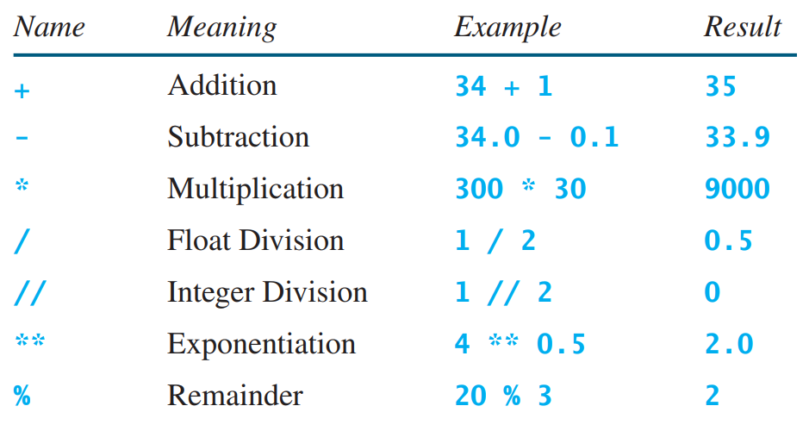
Operators

Slide 4
print
print : Produces text output on the console.
Syntax:
print(“Message”)
print(Expression)
print(Item1, Item2, ..., ItemN)
Example 1:
print(“Hello, world!”)
Exampe 2:
born = 1999
print(“You are”, 2019 – born, “years old.”)

Slide 5
input
input : Reads data from user input.
You can store an input data in a variable.
Example:
name = input(“What is your name? ”)
print(“Hello”, name, “!”)
Output:
What is your name? John
Hello John!

Slide 6
Data Type Conversion
Some data types can be converted into others:
“5”+“3” ≠ 5+3 “5”+“3” ≠ 53 int(“5”)+int(“3”) = 5+3 int(“5”+“3”) = 53
What is the output of following program? n = input("Enter number1: ") m = input("Enter number2: ") print(n + m)

Slide 7
Variables
Variable: A name that refers to a value stored in memory.
variable = expression
area = radius * radius * 3.14
assignment variable operator value operator

Slide 8
Variables
radius = 10
area = radius * radius * 3.14
circumference = 2 * 3.14 * radius
Memory
radius 10
area 314.0
circumference 62.8

Slide 9
Constants
PERMANENT
PI = 3.14159
radius = 10
area = radius * radius * PI
Memory
PI 3.14159
radius 10
area 314.159

Slide 10
Tips
Case sensitive area ≠ Area print() ≠ Print()
Use descriptive names x = 2019 year = 2019
Naming convention lowercase for single word → radius = 10 camelCase for multiple words → numOfStudents = 98 uppercase for constants → PI = 3.14159

Slide 11
Examples
a = 5 (valid or invalid)

Slide 12
Examples
a = 5 (valid or invalid)

Slide 13
Examples
a = 5 (valid or invalid)
5 = a (valid or invalid)

Slide 14
Examples
a = 5 (valid or invalid)
5 = a (valid or invalid)

Slide 15
Examples
a = 5 (valid or invalid)
5 = a (valid or invalid)
abc = h+6 (valid or invalid)

Slide 16
Examples
a = 5 (valid or invalid)
5 = a (valid or invalid)
abc = h+6 (valid or invalid)

Slide 17
Examples
a = 5 (valid or invalid)
5 = a (valid or invalid)
abc = h+6 (valid or invalid)
abc = 5(a+6) (valid or invalid)

Slide 18
Examples
a = 5 (valid or invalid)
5 = a (valid or invalid)
abc = h+6 (valid or invalid)
abc = 5(a+6) (valid or invalid)

Slide 19
Examples
a = 5 (valid or invalid)
5 = a (valid or invalid)
abc = h+6 (valid or invalid)
abc = 5(a+6) (valid or invalid)
abc = 5*(a+6) (valid or invalid)

Slide 20
Examples
a = 5 (valid or invalid)
5 = a (valid or invalid)
abc = h+6 (valid or invalid)
abc = 5(a+6) (valid or invalid)
abc = 5*(a+6) (valid or invalid)

Slide 21
Examples
a = 5 (valid or invalid)
5 = a (valid or invalid)
abc = h+6 (valid or invalid)
abc = 5(a+6) (valid or invalid)
abc = 5*(a+6) (valid or invalid)
a = a + 2 (valid or invalid)

Slide 22
Examples
a = 5 (valid or invalid)
5 = a (valid or invalid)
abc = h+6 (valid or invalid)
abc = 5(a+6) (valid or invalid)
abc = 5*(a+6) (valid or invalid)
a = a + 2 (valid or invalid)

Slide 23
Examples
a = 5 (valid or invalid)
5 = a (valid or invalid)
abc = h+6 (valid or invalid)
abc = 5(a+6) (valid or invalid)
abc = 5*(a+6) (valid or invalid)
a = a + 2 (valid or invalid)
f1 = 5.6 (valid or invalid)

Slide 24
Examples
a = 5 (valid or invalid)
5 = a (valid or invalid)
abc = h+6 (valid or invalid)
abc = 5(a+6) (valid or invalid)
abc = 5*(a+6) (valid or invalid)
a = a + 2 (valid or invalid)
f1 = 5.6 (valid or invalid)

Slide 25
Examples
a = 5 (valid or invalid)
5 = a (valid or invalid)
abc = h+6 (valid or invalid)
abc = 5(a+6) (valid or invalid)
abc = 5*(a+6) (valid or invalid)
a = a + 2 (valid or invalid)
f1 = 5.6 (valid or invalid)
a_str = “Hello” (valid or invalid)

Slide 26
Examples
a = 5 (valid or invalid)
5 = a (valid or invalid)
abc = h+6 (valid or invalid)
abc = 5(a+6) (valid or invalid)
abc = 5*(a+6) (valid or invalid)
a = a + 2 (valid or invalid)
f1 = 5.6 (valid or invalid)
a_str = “Hello” (valid or invalid)

Slide 27
Examples
a = 5 (valid or invalid)
5 = a (valid or invalid)
abc = h+6 (valid or invalid)
abc = 5(a+6) (valid or invalid)
abc = 5*(a+6) (valid or invalid)
a = a + 2 (valid or invalid)
f1 = 5.6 (valid or invalid)
a_str = “Hello” (valid or invalid)
b_str = 'world' (valid or invalid)

Slide 28
Examples
a = 5 (valid or invalid)
5 = a (valid or invalid)
abc = h+6 (valid or invalid)
abc = 5(a+6) (valid or invalid)
abc = 5*(a+6) (valid or invalid)
a = a + 2 (valid or invalid)
f1 = 5.6 (valid or invalid)
a_str = “Hello” (valid or invalid)
b_str = 'world' (valid or invalid)
a+2 = a (valid or invalid)

Slide 29
Examples
a = 5 (valid or invalid)
5 = a (valid or invalid)
abc = h+6 (valid or invalid)
abc = 5(a+6) (valid or invalid)
abc = 5*(a+6) (valid or invalid)
a = a + 2 (valid or invalid)
f1 = 5.6 (valid or invalid)
a_str = “Hello” (valid or invalid)
b_str = 'world' (valid or invalid)
a+2 = a (valid or invalid)

Slide 30
Examples
a = 5 (valid or invalid)
5 = a (valid or invalid)
abc = h+6 (valid or invalid)
abc = 5(a+6) (valid or invalid)
abc = 5*(a+6) (valid or invalid)
a = a + 2 (valid or invalid)
f1 = 5.6 (valid or invalid)
a_str = “Hello” (valid or invalid)
b_str = 'world' (valid or invalid)
a+2 = a (valid or invalid)
a+b = 5 (valid or invalid)

Slide 31
Examples
a = 5 (valid or invalid)
5 = a (valid or invalid)
abc = h+6 (valid or invalid)
abc = 5(a+6) (valid or invalid)
abc = 5*(a+6) (valid or invalid)
a = a + 2 (valid or invalid)
f1 = 5.6 (valid or invalid)
a_str = “Hello” (valid or invalid)
b_str = 'world' (valid or invalid)
a+2 = a (valid or invalid)
a+b = 5 (valid or invalid)

Slide 32
Exercises

Slide 33

Math Equation
Write a Python program to solve the following mathematical equation for x=1, y=4, z=0.25
Hint 1: Define variables for x, y, and z
Hint 2: You can use ** operator to take square root
$$\frac{{\left(2x+y\right)}^{2}\sqrt{z}}{\sqrt{x}+\sqrt{y}}$$

Slide 34
Temperature
Write a Python program that asks the user for a number as a temperature in Celsius then converts it to Fahrenheit and prints it.
Hint 1: You will need eval function or conversion.
Hint 2: T_{(°F)} = T_{(°C)} × 1.8 + 32

Slide 35
Velocity
Write a program that solves the following problem: There are two cars that start at the same time and drive towards each other. Velocity of the cars are fixed at 80 km/h and 70 km/h. At the beginning, the distance between the cars is 490 km. After how many minutes will the distance between them be 150 km?

Slide 36
Hypotenuse
Write a program that asks the user for the length of perpendicular edges of a right triangle, then calculates the hypotenuse and prints it.
E.g. For the inputs 3 and 4, the output should be 5.

